Slide 1
Systems Analysis and Design 10th Edition
Chapter 2
Analyzing the Business Case

Slide 2
Chapter Objectives
Explain the concept of a business case and how a business case affects an IT project
Describe the strategic planning process and why it is important to the IT team
Explain the purpose of a mission statement
Conduct a SWOT analysis and describe the four factors involved
Explain how the SDLC serves as a framework for systems development

Slide 3
Chapter Objectives (Cont.)
List reasons for systems projects and factors that affect such projects
Describe systems requests and the role of the systems review committee
Define operational, technical, economic, and schedule feasibility
Describe the steps and the end product of a preliminary investigation

Slide 4
Introduction
Analysts must consider company’s mission, objectives, and IT needs
Process starts with a systems request
Preliminary investigation follows to evaluate:
Feasibility study
Fact finding techniques
Reporting to management
Notes:
Review a proposal to determine if it presents a strong business case. Business case refers to the reasons or justification for a proposal. To analyze must consider the company’s overall mission, objectives and IT needs.
IT managers have to be involved to be able to plan for future growth.

Slide 5
A Framework for IT Systems Development
Strategic Planning Overview
Starts with a mission statement
Continues with goals and objectives
Long and short-term goals identified
What Is SWOT Analysis
An enterprise SWOT analysis usually begins with these questions:
What are our strengths, and how can we use them to achieve our business goals?
What are our weaknesses, and how can we reduce or eliminate them?
What are our opportunities, and how do we plan to take advantage of them?
What are our threats, and how can we assess, manage, and respond to the possible risks?
Notes:
Strategic planning is the process of identifying long-term organizational goals, strategies, and resources. Focuses on a horizon that is 3, 5, 10 years in the futures.
SWOT stands for Strengths, Weaknesses, Opportunities and Threats

Slide 6
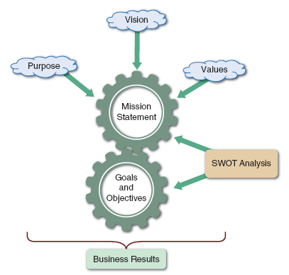
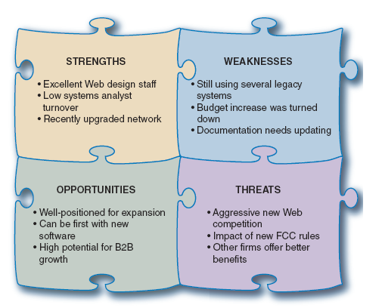
A Framework for IT Systems Development (Cont.)
FIGURE 2-3 Strategic planning is a dynamic process that starts with a mission statement, which is shaped by the firm’s purpose, vision, and values. The mission generates goals and objectives that produce business results.
FIGURE 2-4 A SWOT analysis might produce similar results to those shown here
Notes:
Strategic planning starts with a mission statement that reflects the firm’s vision, purpose, and values.
Fig 2-3 is a typical process for strategic planning
Fig 2-4 shows samples of typical strengths, weaknesses, opportunities, and threats, AKA SWOT
SWOT Analysis can focus on a specific project or project, an operating division, the entire company or the mission statement itself. The overall aim is to avoid seeking goals that are unrealistic, unprofitable or unachievable.
Focuses on 4 questions
A SWOT analysis examines a firm’s technical, human, and financial resources

Slide 7
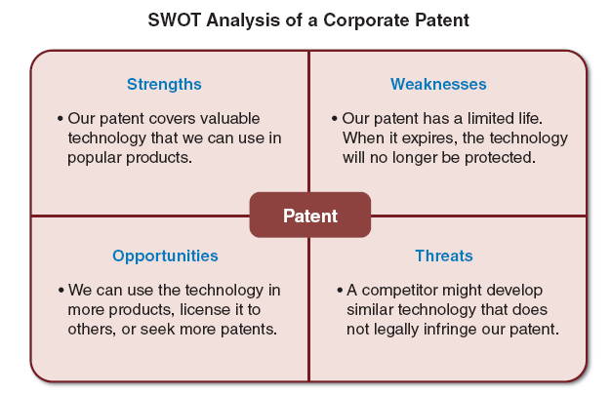
A Framework for IT Systems Development (Cont.)
FIGURE 2-5 This SWOT analysis example focuses on a specific asset, such as a company patent.
Notes:
Planning is essential and it must be started as soon as possible.
The above example is a sample SWOT analysis of a specific asset, a company patent.
Depending on the company they may start planning with a mission statement, others start with a SWOT assessment. All consider it a dynamic process.

Slide 8
A Framework for IT Systems Development (Cont.)
Strategic Planning for IT Projects
Careful planning can help assure that:
The project supports overall business strategy and operational needs
The project scope is well-defined and clearly stated
The project goals are realistic, achievable, and tied to specific statements, assumptions, constraints, factors, and other inputs
Notes:
Previous slides were about planning at the corporate level, but what about specific IT systems and projects? A similar approach to the corporate is generally used. Analysts know that planning is essential for IT project success and must start as early as possible

Slide 9
A Framework for IT Systems Development (Cont.)
Planning Tools
Some analysts use traditional text-based methods like Microsoft Word
Some analysts prefer a spreadsheet method like Microsoft Excel
The most effective approach is to use a CASE tool such as Visible Analyst
Notes:
First step is to select a planning tool.
And what you use depends on the company or if you are developing a tool for your own use. Visible Analyst is an expensive too (most tools are). Many different tools can be used for all levels of the company
CASE – Computer-Aided Software Engineering
Examples of CASE tools – diagram tools, documentation tools, process modeling tools, analysis and design tools, system software tools, project management tools, design tools, prototyping tools, configuration manage tools, programming tools, Web development tools, testing tools, maintenance tools, quality assurance tools, database management tools and re-engineering tools.
CASE tools divided into 3 categories: Upper CASE tools, Lower CASE tools and Integrated CASE tools.
Upper CASE - support the analysis and design phase of a software system and include tools such as report generators and analysis tools
Lower CASE - code designers and program editors, and these tools support the coding, testing and debugging phase
Integrated CASE - support the analysis, design and coding phase.

Slide 10
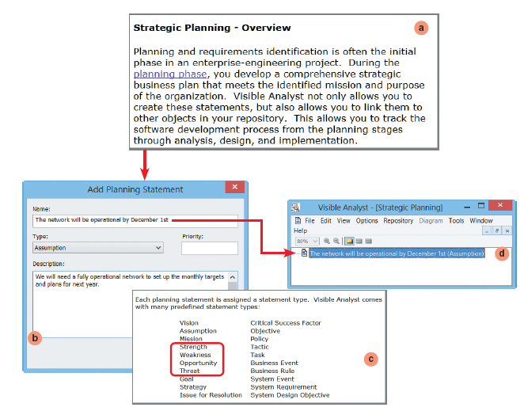
A Framework for IT Systems Development (Cont.)
FIGURE 2-6 The Visible Analyst CASE tool supports strategic planning and allows a user to enter many kinds of planning statements. Notice the four SWOT categories highlighted in the list.
Notes:
Sample of Visible Analyst

Slide 11
A Framework for IT Systems Development (Cont.)
A New Role for the IT Department
Management and IT are linked closely, and remarkable changes have occurred in both areas
Today, systems development is much more team- oriented
Although team-oriented development is the norm, some companies see the role of the IT department being screening and evaluating systems requests
Larger firms are more likely to use an evaluation team or systems review committee
Notes:
Generally now users, IT department and managers working right from the start

Slide 12
What Is a Business Case?
A business case refers to the reasons, or justification, for a proposal
Should be comprehensive, yet easy to understand
Should describe the project clearly, provide the justification to proceed, and estimate the project’s financial impact
Notes:
The reasons or justifications that a project should be developed

Slide 13
What Is a Business Case?(Cont.)
A business case should answer the following questions:
Why are we doing this project?
What is the project about?
How does this solution address key business issues?
How much will it cost?
How long will it take?
Will we suffer a productivity loss during the transition?

Slide 14
What Is a Business Case?(Cont.)
A business case should answer the following questions (Cont.):
What is the return on investment and payback period?
What are the risks of doing the project?
What are the risks of not doing the project?
How will we measure success?
What alternatives exist?

Slide 15
Information Systems Projects
Main Reasons for Systems Requests:
Improved Service
Improving service to customers or users within the company
Support for New Products and Services
New products and services often require new types or levels of IT support
Better Performance
Current system might not meet performance requirements
Notes:
Service – providing better and newer service opportunities – different way to view investment portfolio
New Products – obsolescence, vendor might change might require and upgrade
Performance – system responds slowly at times. System designed for one hardware and a newer hardware is being used.

Slide 16
Information Systems Projects(Cont.)
Factors That Affect Systems Projects
Internal Factors
Strategic Plan
Top Managers
User Requests
Information Technology Department
Existing Systems and Data
External factors
Technology
Suppliers
Customers
Competitors
The Economy
Government
Notes:
Strategic plan – sets the overall goals for the company and can generate or change IT projects
Managers – generally initiate large projects
User Requests – as users use a project more, they will request changes and improvements
IT – could be equipment requests, or proposing a new data collection system
Existing systems – error that occur in existing systems can trigger requests for projects
Technology – new technologies spur requests
Suppliers – technology has made the interaction between suppliers and a company much closer. The suppliers may request that parts be coded in a manner that is consistent with their systems
Customers – vitally important to any business
Competition – matching what the competitor is doing
Economy – in an expanding economy, systems need to be scalable to handle more growth
Government – up-to-date IRS reporting. Federal, State and local government all require different types of reporting.

Slide 17
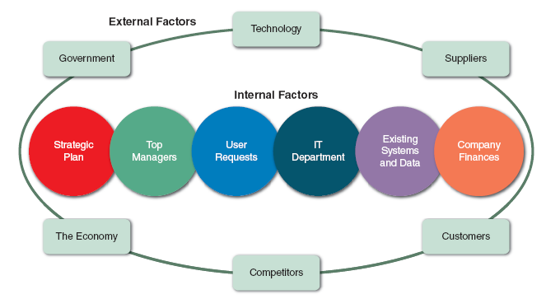
Information Systems Projects(Cont.)
Factors That Affect Systems Projects
FIGURE 2-10 Internal and external factors that affect IT projects.
Notes:
All of these impact or have influence projects

Slide 18
Evaluation of Systems Requests
Systems Request Forms should:
Streamlines the request process
Ensures consistency
Easy to understand
Includes clear instructions
Indicates what supporting documents are needed
Submitted electronically
Notes:
Most IT departments receive more requests than they can handle. So they need to streamline the review process. Most use some sort of formal request. And then have
A review committee to evalulate and rank the requests.

Slide 19
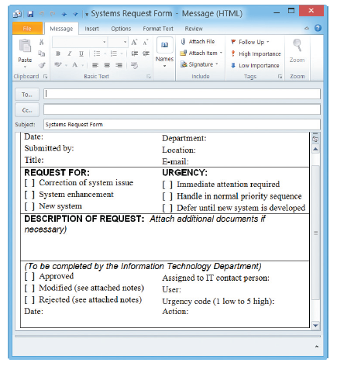
Evaluation of Systems Requests(Cont.)
FIGURE 2-13 Example of an online systems request form.
Notes:
Sample form – formal request for a system change, improvement, new system

Slide 20
Evaluation of Systems Requests(Cont.)
Systems Review Committee
With a broader viewpoint, a committee can establish priorities more effectively than an individual
One person’s bias is less likely to affect the decisions
Disadvantages:
Action on requests must wait until the committee meets
Members might favor projects requested by their own departments
Internal political differences could delay important decisions
Notes:
Most large corporations use a systems review committee. But even an independent contractor should have a plan for reviewing requests and then prioritizing them.

Slide 21
Overview of Feasibility
Is the proposal desirable in an operational sense?
Is it a practical approach that will solve a problem or take advantage of an opportunity to achieve company goals?
Is the proposal technically feasible?
Are the necessary technical resources and people available for the project?
Is the proposal economically desirable?
What are the projected savings and costs?
Are other intangible factors involved, such as customer satisfaction or company image?
Is the problem worth solving, and will the request result in a sound business investment?
Can the proposal be accomplished within an acceptable time frame?
Notes:
A systems request must pass several tests, called a feasibility study to see whether it is worthwhile to proceed further. Sometimes the feasibility studies can be done in a few hours, others take days to get all the facts gathered.

Slide 22
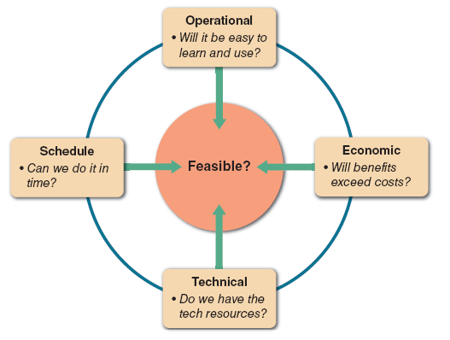
Overview of Feasibility (Cont.)
FIGURE 2-14 A feasibility study examines operational, technical, economic,
and schedule factors.
Notes:
4 categories of feasibility

Slide 23
Overview of Feasibility (Cont.)
Operational Feasibility
Does management support the project?
Do users support the project?
Is the current system well liked and effectively used?
Do users see the need for change?
Will the new system result in a workforce reduction?
If so, what will happen to affected employees?
Will the new system require training for users?
If so, is the company prepared to provide the necessary resources for training current employees?
Will users be involved in planning the new system right from the start?

Slide 24
Overview of Feasibility (Cont.)
Operational Feasibility (Cont.)
Will the new system place any new demands on users or require any operating changes?
For example:
Will any information be less accessible or produced less frequently?
Will performance decline in any way? If so, will an overall gain to the organization outweigh individual losses?
Will customers experience adverse effects in any way, either temporarily or permanently?
Will any risk to the company’s image or goodwill result?
Does the development schedule conflict with other company priorities?
Do legal or ethical issues need to be considered?

Slide 25
Overview of Feasibility (Cont.)
Technical Feasibility
Does the company have the necessary hardware, software, and network resources?
If not, can those resources be acquired without difficulty?
Does the company have the needed technical expertise?
If not, can it be acquired?
Does the proposed platform have sufficient capacity for future needs?
If not, can it be expanded?

Slide 26
Overview of Feasibility (Cont.)
Technical Feasibility (Cont.)
Will a prototype be required?
Will the hardware and software environment be reliable?
Will it integrate with other company information systems, both now and in the future?
Will it interface properly with external systems operated by customers and suppliers?
Will the combination of hardware and software supply adequate performance?
Do clear expectations and performance specifications exist?
Will the system be able to handle future transaction volume and company growth?

Slide 27
Overview of Feasibility (Cont.)
Economic Feasibility
Costs for people, including IT staff and users
Costs for hardware and equipment
Cost of software, including in-house development as well as purchases from vendors
Cost for formal and informal training, including peer-to-peer support
Cost of licenses and fees
Cost of consulting expenses
Facility costs
The estimated cost of not developing the system or postponing the project
Notes:
Toolkit C in the back of the book covers Financial Analysis tools

Slide 28
Overview of Feasibility (Cont.)
Tangible Benefits
A new scheduling system that reduces overtime
An online package tracking system that improves service and decreases the need for clerical staff
A sophisticated inventory control system that cuts excess inventory and eliminates production delays
Intangible Benefits
A user-friendly system that improves employee job satisfaction
A sales tracking system that supplies better information for marketing decisions
A new Web site that enhances the company’s image
Notes:
Can Tangible lead to Intangible and vice versa?

Slide 29
Overview of Feasibility (Cont.)
Schedule Feasibility
Can the company or the IT team control the factors that affect schedule feasibility?
Has management established a firm timetable for the project?
What conditions must be satisfied during the development of the system?
Will an accelerated schedule pose any risks?
If so, are the risks acceptable?
Will project management techniques be available to coordinate and control the project?
Will a project manager be appointed?

Slide 30
Overview of Feasibility (Cont.)
FIGURE 2-14 A feasibility study examines operational, technical, economic,
and schedule factors.

Slide 31
5th Area of Feasibility
Some organizations include 5th area
Organizational and Cultural Feasibility
Is a proposed project consistent with corporate norms

Slide 32
Evaluating Feasibility
Identify and weed out systems requests that are not feasible
Even if the request is feasible, it might not be necessary
Requests that are not currently feasible can be resubmitted as new hardware, software, or expertise becomes available
Reject proposals that are not feasible

Slide 33
Question
Suppose the vice president of marketing asks you to write a program to create labels for a one-time advertising manager. As IT manager, you know that labels can be prepared more efficiently by exporting the data to a word processing program and using a mail merge feature.
How would you handle this situation?

Slide 34
Overview of Feasibility (Cont.)
FIGURE 2-14 A feasibility study examines operational, technical, economic,
and schedule factors.

Slide 35
Setting Priorities
Factors That Affect Priority
Will the proposed system reduce costs?
Where? When? How? How much?
Will the system increase revenue for the company?
Where? When? How? How much?
Will the systems project result in more information or produce better results?
How? Are the results measurable?
Will the system serve customers better?
Will the system serve the organization better?
Can the project be implemented in a reasonable time period?
How long will the results last?
Are the necessary financial, human, and technical resources available?

Slide 36
Setting Priorities (Cont.)
Discretionary Projects
Projects where management has a choice in implementing them
Creating a new report for a user
Nondiscretionary Projects
Projects where management has must implement them
Adding a report required by federal law
Most of these projects are predictable
Annual updates to payroll
Tax percentages
Quarterly changes

Slide 37
Attaway Airlines, Part One
You are the IT director at Attaway Airlines, a small regional air carrier. You chair the company’s systems review committee, and you currently are dealing with strong disagreements about two key projects. Dan Esposito, the marketing manager, says it is vital to have a new computerized reservation system that can provide better customer service and reduce operational costs. Molly Kinnon, vice president of finance, is equally adamant that a new accounting system is needed immediately because it will be very expensive to adjust the current system to new federal reporting requirements. Molly outranks Dan, and she is your boss. The next meeting, which promises to be a real showdown, is set for 9:00 a.m. tomorrow. How will you prepare for the meeting? What questions and issues should be discussed?
Notes:
Common problem – competition between 2 departments. The question is “What is the best course of action for the business?”

Slide 38
Attaway Airlines, Part Two
Back at Attaway Airlines, the morning meeting ended with no agreement between Dan Esposito and Molly Kinnon. In fact, a new issue arose. Molly now says that the new accounting system is entitled to the highest priority because the federal government soon will require the reporting of certain types of company-paid health insurance premiums. Because the current system will not handle this report, she insists that the entire accounting system is a nondiscretionary project. As you might expect, Dan is upset. Can part of a project be nondiscretionary? What issues need to be discussed? The committee meets again tomorrow, and the members will look to you, as the IT director, for guidance.
Notes:
If a project is mandatory, it must be pursued. See if other options available. Would a stand-along reporting module satisfy the government requirement? This would let Attaway make decisions based on business-related factors, not external forces. Again, “What is in the best interest of Attaway?”

Slide 39
Preliminary Investigation Overview
Interaction with Managers and Users
Meet with key managers, users, and IT staff to describe the project, explain responsibilities, answer questions, and invite comments
Focus on improvements and enhancements, not problems

Slide 40
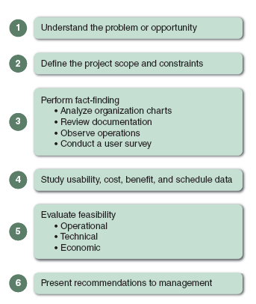
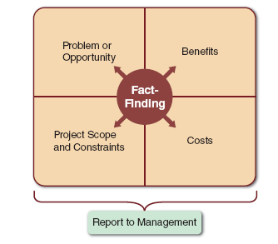
Preliminary Investigation Overview (Cont.)
FIGURE 2-15 Model of a preliminary investigation. Notice the importance of fact-finding in each of the four areas.
FIGURE 2-16 Six main steps in a typical preliminary investigation.

Slide 41
Preliminary Investigation Overview (Cont.)
Step 1: Understand the Problem or Opportunity
Develop a business profile that describes business processes and functions
Understand how modifications will affect business operations and other information systems
Determine which departments, users, and business processes are involved
Systems request may not reveal an underlying problem
Consider using a fishbone diagram

Slide 42
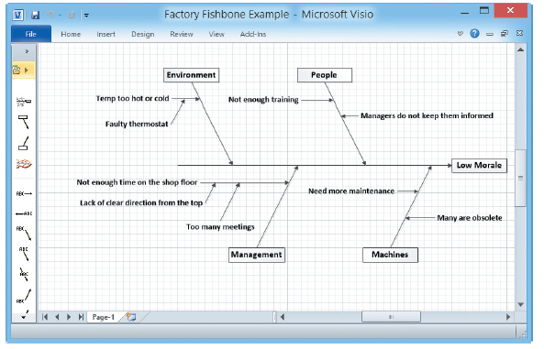
Preliminary Investigation Overview (Cont.)
FIGURE 2-17 A fishbone diagram displays the causes of a problem. Typically, you must dig deeper to identify actual causes rather than just symptoms.

Slide 43
Preliminary Investigation Overview (Cont.)
Step 2: Define the Project Scope and Constraints
Define the specific boundaries, or extent, of the project
Define project scope by creating a list with sections called Must Do, Should Do, Could Do, and Won’t Do
Define project scope as clearly as possible to avoid project creep
Identify Constraints
A constraint is a requirement or condition that the system must satisfy or an outcome that the system must achieve

Slide 44
Project Creep – aka focus creep, feature creep, function creep, and requirement creep
the gradual alteration of deadlines and expansion of targets as a project progresses
a project grows from its original parameters into something more. For example, you agree to write two articles, but are asked later to also market those articles through social media outlets- with no mention of adjusting fees.

Slide 45
Project Creep – cont’d
Featuritis: “We’d like to add these features that weren’t included in the initial project.”
When software developers are asked to haphazardly include strange, orphaned features, their software becomes bloated with additions that seem out of place. Hence the term “software bloat.”

Slide 46
How avoid Project Creep
Define scope clearly and accurately
developing realistic expectations for budget and schedule
Stay focused on the goals –
a simple $500 change could throw the project off
While we are writing this we might as well….isn’t a good reason
Keep a list of change requests for future updates

Slide 47
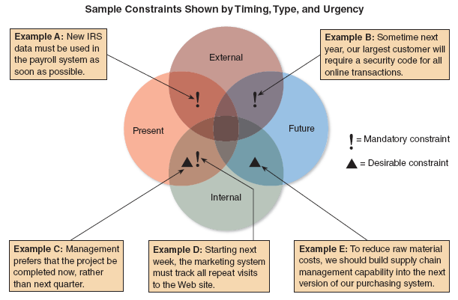
Preliminary Investigation Overview (Cont.)
FIGURE 2-18 Examples of various types of constraints.

Slide 48
Preliminary Investigation Overview (Cont.)
Step 3: Perform Fact-Finding
Gather data about project usability, costs, benefits, and schedules
Analyze organization charts
Understand the functions and identify people you want to interview
Conduct Interviews
Determine the people to interview
Establish objectives for the interview
Develop interview questions
Prepare for the interview
Conduct the interview
Document the interview
Evaluate the interview

Slide 49

Preliminary Investigation Overview (Cont.)
Step 3: Perform Fact-Finding (Cont.)
Review Documentation
Investigate the current system documentation
Check with users to confirm that you are receiving accurate and complete information
Observe Operations
See how workers carry out typical tasks
Sample inputs and outputs of the system
FIGURE 2-20 Sometimes, an analyst can get a better understanding of a system by watching actual operations.

Slide 50
Preliminary Investigation Overview (Cont.)
Step 3: Perform Fact-Finding (Cont.)
Conduct a User Survey
A survey is not as flexible as a series of interviews, but it is less expensive, generally takes less time, and can involve a broad cross-section of people
Analyze the Data
Systems analyst might use a Pareto chart
Analysts may use an XY chart to identify if there is a correlation of variables

Slide 51
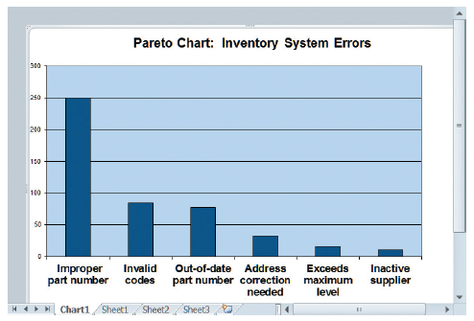
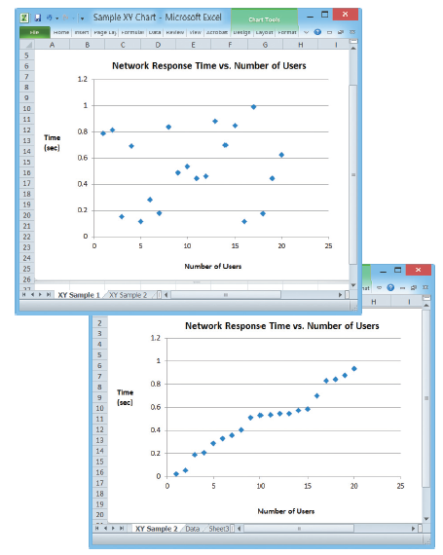
Preliminary Investigation Overview (Cont.)
FIGURE 2-21 A Pareto chart displays the causes of a problem, in priority order, so an analyst can tackle the most important causes first. In this example, the part number issue would be the obvious starting point.
FIGURE 2-22 An XY chart shows correlation between variables, which is very important in problem solving. Conversely, a lack of correlation suggests that the variables are independent, and that you should look
elsewhere for the cause.

Slide 52
Preliminary Investigation Overview (Cont.)
Step 4: Analyze Project Usability, Cost, Benefit, and Schedule Data
What information must you obtain, and how will you gather and analyze the information?
Will you conduct interviews? How many people will you interview, and how much time will you need to meet with the people and summarize their responses?
Will you conduct a survey? Who will be involved? How much time will it take people to complete it? How much time will it take to tabulate the results?
How much will it cost to analyze the information and prepare a report with findings and recommendations?

Slide 53
Preliminary Investigation Overview (Cont.)
Step 5: Evaluate Feasibility
OPERATIONAL FEASIBILITY
Review of user needs, requirements, and expectations
Look for areas that might present problems for system users and how they might be resolved
TECHNICAL FEASIBILITY
Identify the hardware, software, and network resources needed to develop, install, and operate the system
Develop a checklist that will highlight technical costs and concerns
ECONOMIC FEASIBILITY
Apply the financial analysis tools
The cost-benefit data will be important
SCHEDULE FEASIBILITY
Include stakeholder expectations regarding acceptable timing and completion dates

Slide 54
Preliminary Investigation Overview (Cont.)
Step 6: Present Results and Recommendations to Management
Typical Report Includes:
Introduction
Systems Request Summary
Findings
Case for Action
Project Roles
Time and Costs Estimates
Expected Benefits
Appendix

Slide 55
Chapter Summary
Systems planning is the first phase of the systems development life cycle
A business case should describe the project clearly, provide the justification to proceed, and estimate the project’s financial impact
Various internal and external factors affect systems projects, such as user requests, top management directives, existing systems, the IT department, software and hardware vendors, technology, customers, competitors, the economy, and government

Slide 56
Chapter Summary (Cont.)
Analysts evaluate the systems request and determine whether the project is feasible from an operational, technical, economic, and schedule standpoint
Steps in the preliminary investigation are:
Understand the problem or opportunity
Define the project scope and constraints
Perform fact-finding
Analyze project usability, cost, benefit, and schedule data
Evaluate feasibility
Present results and recommendations to management

